Slide 1
ECED3901 Design Methods II
Lecture #3: Project Management
Colin O’Flynn

Slide 2
What are we covering?
Project Design moving to Project Management
Making a realistic schedule

Slide 3
Example: Mailing 500 Items
Q: I need you to mail out 500 boxes. I have a printed list of addresses. The boxes are all uniform size, but you will need to print labels/postage using a web service.
How long will this take?

Slide 4
Solving this…
Getting box, folding out:
Getting widget from stores:
Adding padding:
Taping box:
Printing postage / labels:
Total:

Slide 5
Solving this…
Getting box, folding out: 45 seconds
Getting widget from stores: 15 seconds
Adding padding: 45 seconds
Taping box: 30 seconds
Printing postage / labels: 120 seconds
Total: 4.25 min/box
4.25 * 500 = 2125 mins
2125 / 60 = 35 hours(!)

Slide 6
Project Management 101

Slide 7
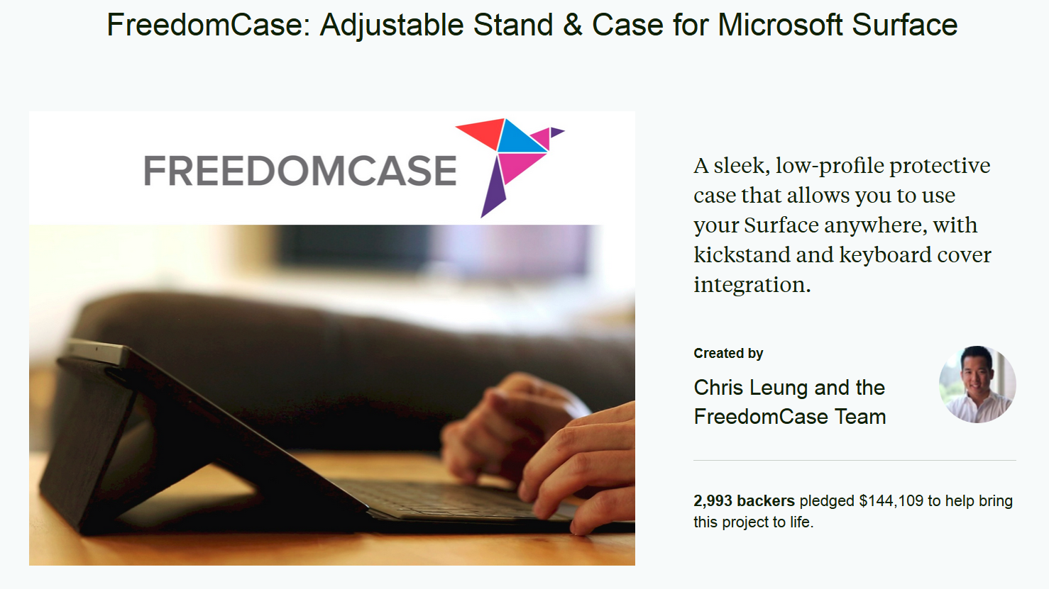
Kickstarter Project Management

Slide 8
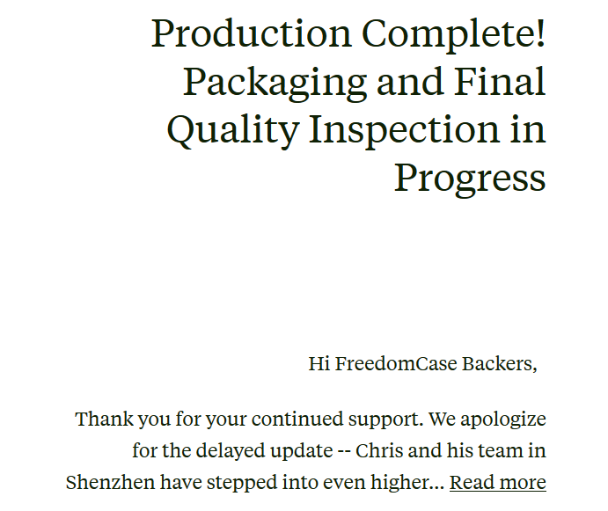
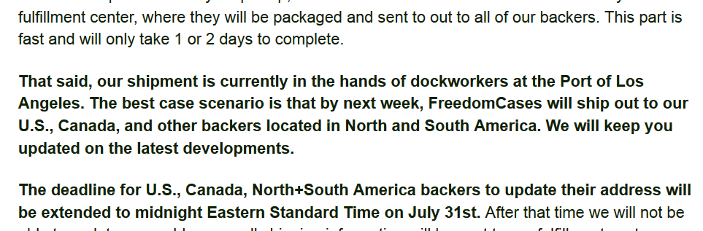
Kickstarter Project Management

Slide 9
Patents
**THIS IS NOT LEGAL ADVICE. I AM NOT A LAWYER.**

Slide 10
Patents
Prevents someone else from selling a device which ‘infringes’ on your claims
Is *NOT* a license to sell the device, is possible your device still infringes on someone else's patent
Only enforceable in geographic area issued in (i.e. US, Canada, UK, China, etc.)
A patent is effectively a legal proceeding
The patent office (and later possibly a third party) is using standard legal procedure to reach a ‘verdict’
Your initial claims that will be examined are your patent application
**THIS IS NOT LEGAL ADVICE. I AM NOT A LAWYER.**

Slide 11
Reading a Patent
Important Sections:
1) Claims
2) Everything else
The ‘Claims’ is solely what is claimed as the innovative material.
The ‘Specification’ must detail how it works etc., and can restrict the claims. However lots of material written in the specification may be well-known already.
Prior art must read on the claims.
**THIS IS NOT LEGAL ADVICE. I AM NOT A LAWYER.**

Slide 12
Patent Application
A patent application IS NOT a patent
**THIS IS NOT LEGAL ADVICE. I AM NOT A LAWYER.**

Slide 13
Patent Application
Patent Application = I have $400 USD. That is all it means.
A patent application that is fairly likely to be enforceable is >$5 000 normally
Defending a patent can easily cost > $50 000, after which point it has more value
Failures in the original application might mean someone can easily circumvent your patent, lets see some examples:
**THIS IS NOT LEGAL ADVICE. I AM NOT A LAWYER.**

Slide 14
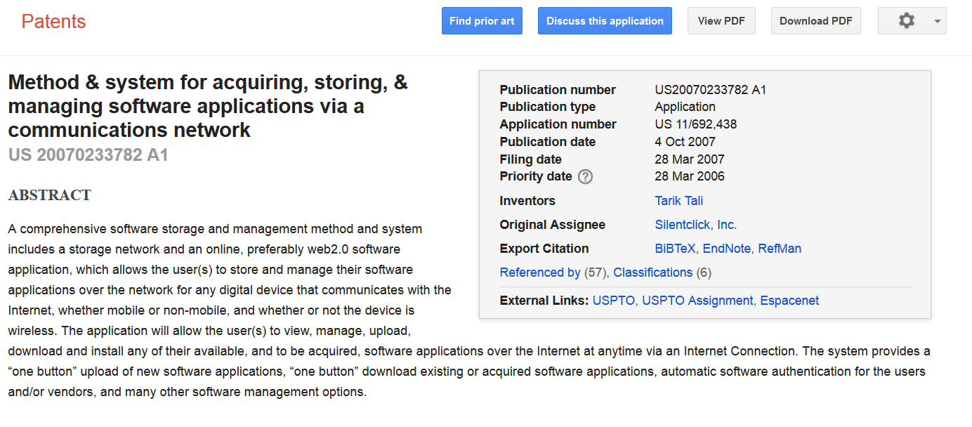
Example: Looking up a Patent
scholar.google.ca

Slide 15
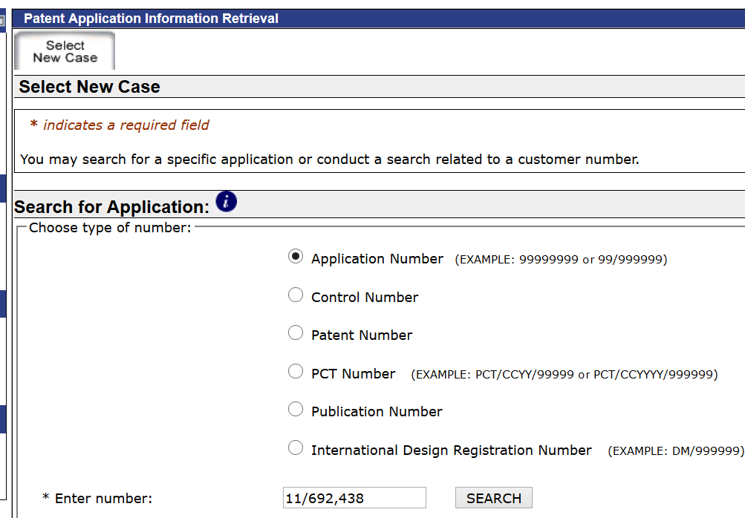
Example: Getting Patent Details
USPTO Public Pair
http://portal.uspto.gov/pair/PublicPair

Slide 16
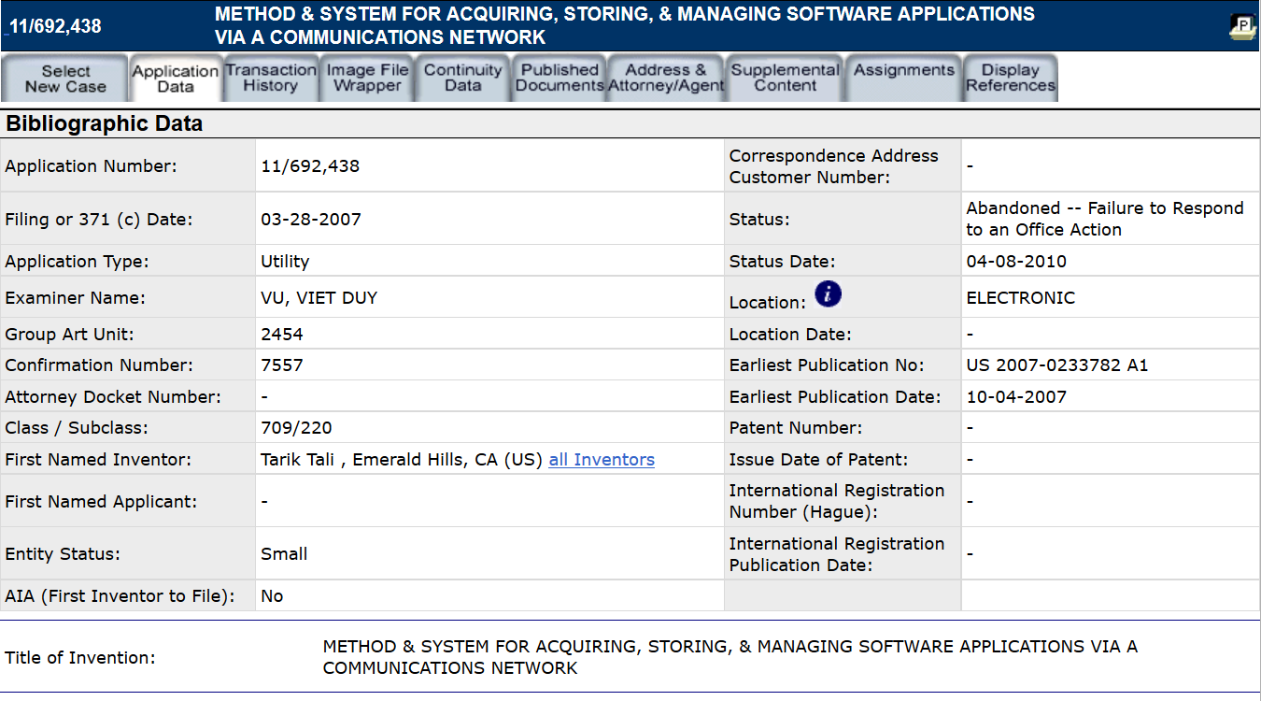
Examples: Getting Patent Details

Slide 17
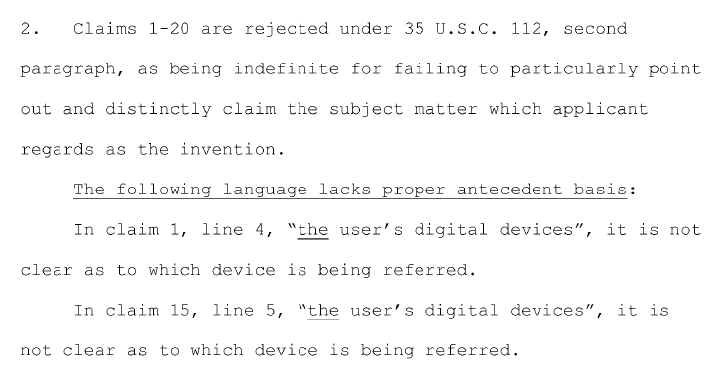
Examples: Getting Patent Details

Slide 18
Checking Patent Status
**THIS IS NOT LEGAL ADVICE. I AM NOT A LAWYER.**

Slide 19
EMC/Safety Tests

Slide 20
EMC Testing (Intentional Radiators)

Slide 21
EMC Testing (unintentional radiator)

Slide 22
UL/Other Requirements

Slide 23
Resources

Slide 24
Summary

